Slide 1
PATIENT REGISTRATION SYSTEM
BY
Udaykiran S
Ravitheja S

Slide 2
Scenario:
Our system is used to support Online Patient Registration .
Our system displays the available slots for an appointment in a particular day.
Doctor can check for appointments of the day

Slide 3
Actors:
Administrator
Doctor
Operator
Patient

Slide 4
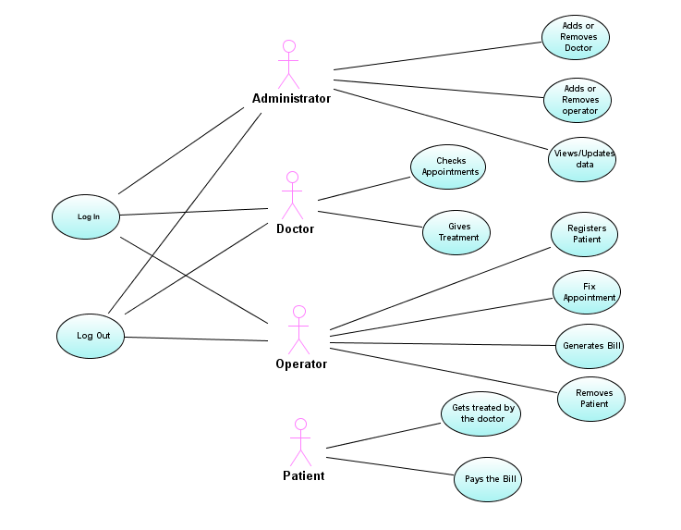
Use case diagram

Slide 5
Administrator
Administrator manages the data in the database
He can add doctor or operator and manage the details

Slide 6
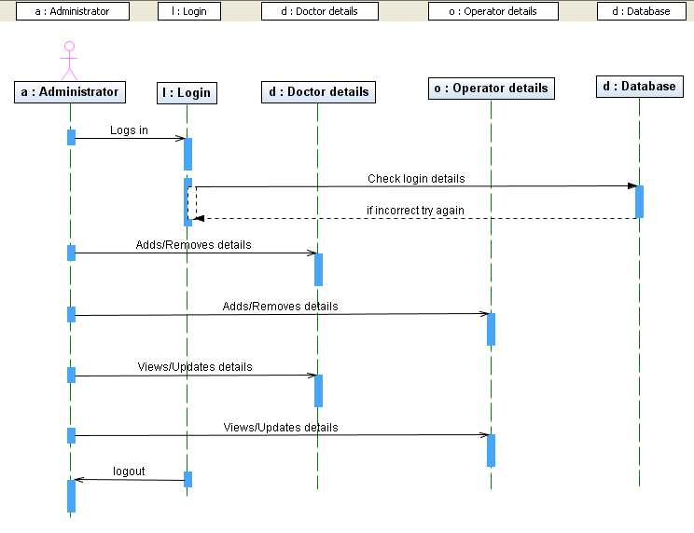
Sequence diagram of administrator

Slide 7
Doctor:
Doctor checks his appointments with the patients using his page.
Treats the patients.

Slide 8
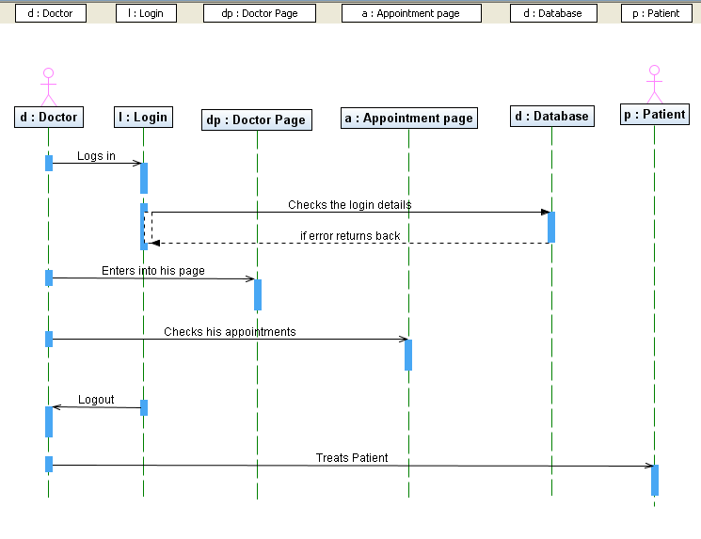
Sequence diagram of doctor

Slide 9
Operator
Operator registers the patient and fixes appointment with the doctor.
He generates the bill according to the treatment taken.
And he can even delete the patient if necessary.

Slide 10
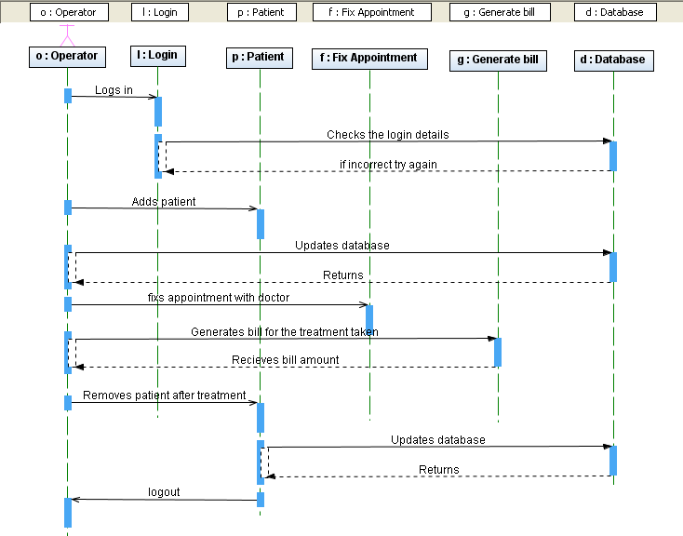
Operator

Slide 11
Patient
Patient takes the treatment from the doctor.
Pays the bill.

Slide 12
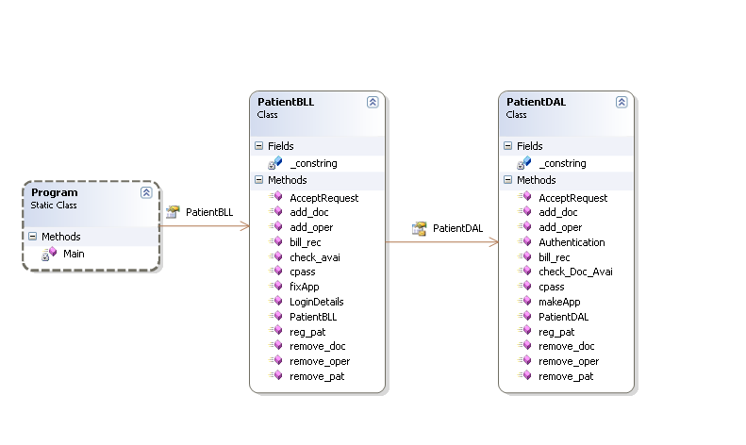
Class diagram

Slide 13
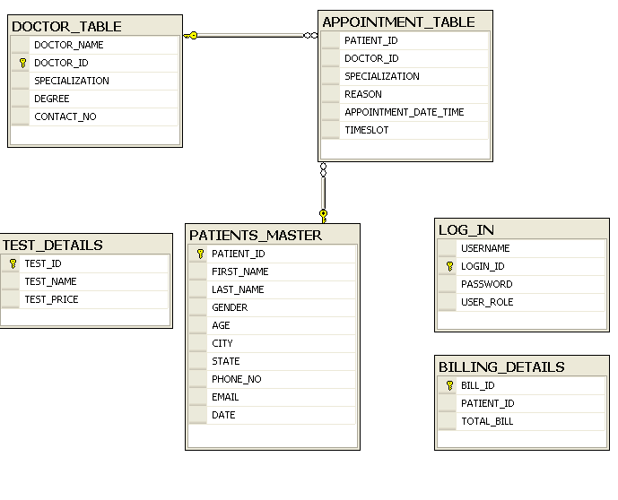
Database diagram

Slide 14
Thank you!

